Slide 1
First Jakarta EE application
Intellij Idea Ultimate edition.
Adnan Majeed
Lecturer CS

Slide 2
Create a new Jakarta EE project﻿
IntelliJ IDEA includes a dedicated wizard for creating Jakarta Enterprise projects based on various Jakarta EE implementations. In this tutorial, we will create a simple web application.
In the main menu, go to File | New | Project.
In the New Project dialog, select Jakarta EE.
Enter a name for your project: JakartaEEHelloWorld.
Select the Web application template, Maven as a build tool, and use Oracle OpenJDK 17 as the project SDK. Don't select or add an application server, we will do it later.
Click Next to continue.

Slide 3
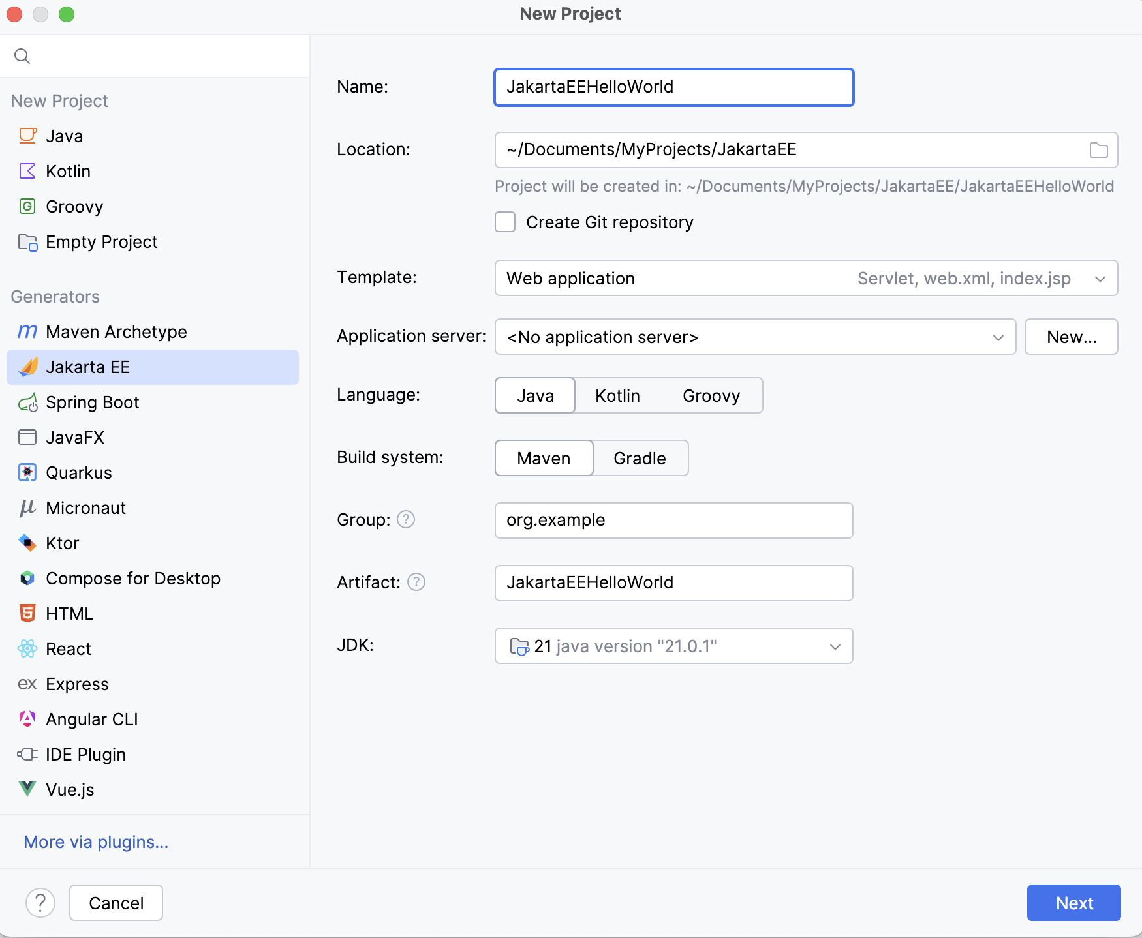

Slide 4
In the Version field, select Jakarta EE 11 because that's what Tomcat 11 used in this tutorial is compatible with.
For Tomcat 9, select Java EE 8. For Tomcat 10, select Jakarta EE 9.1.
In the Dependencies list, you can see that the web application template includes only the Servlet framework under Specifications.

Slide 5
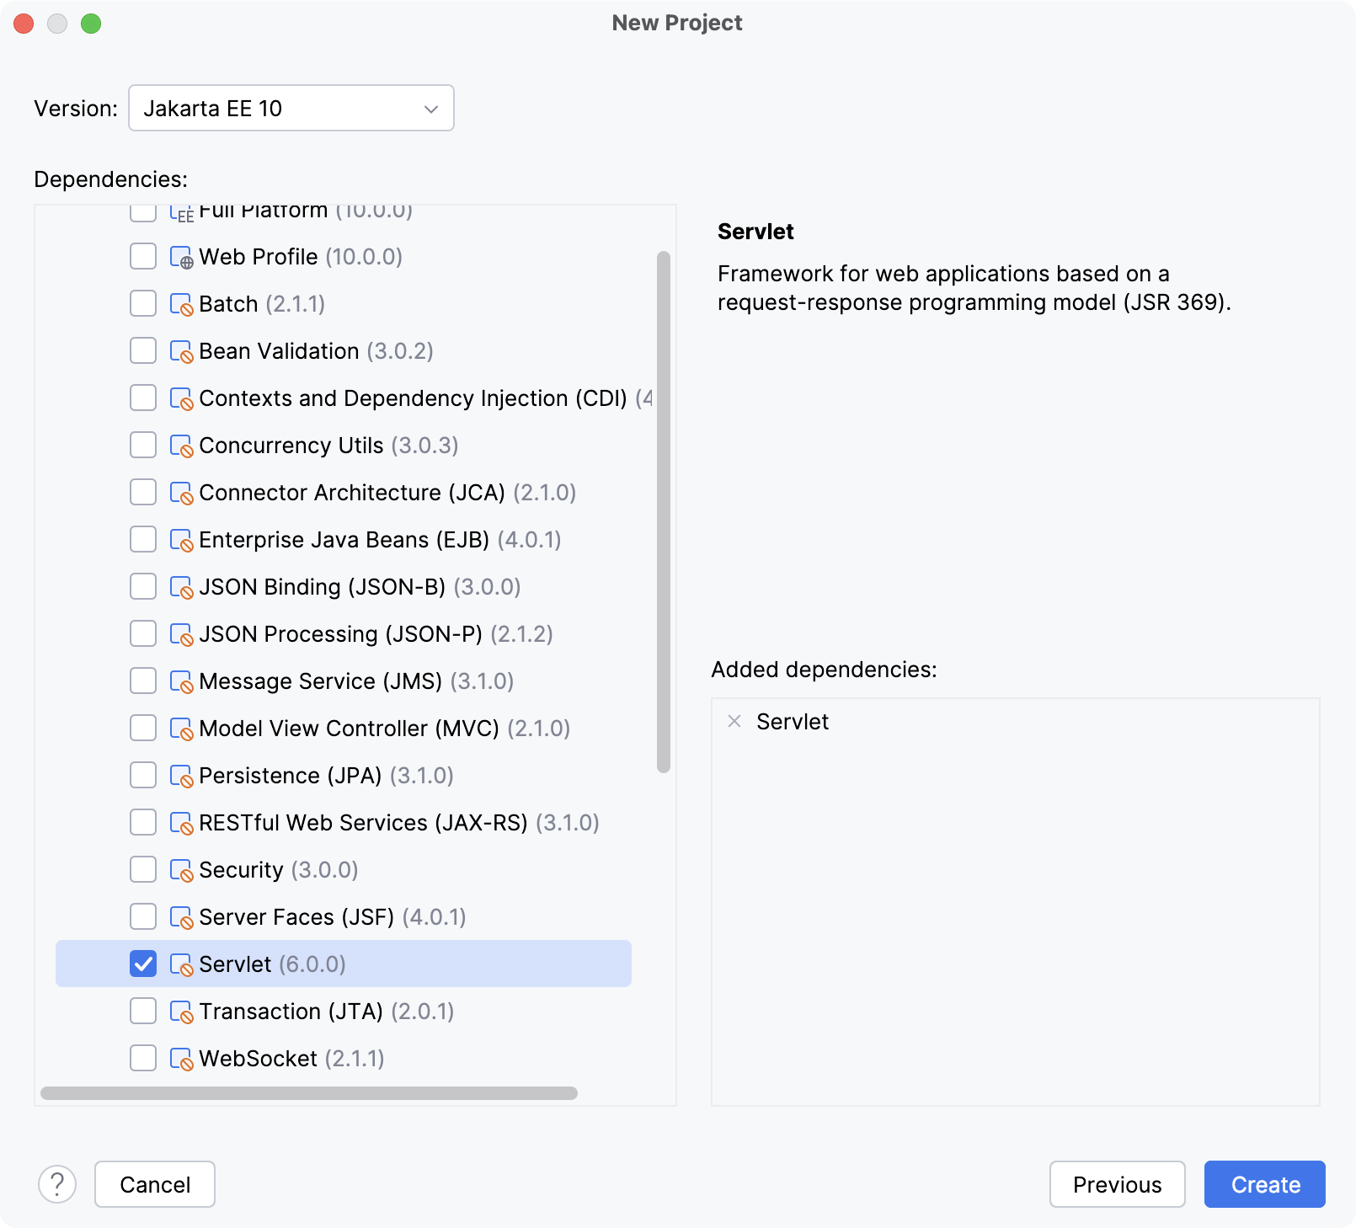

Slide 6
Explore the default project structure﻿
IntelliJ IDEA creates a project with some boilerplate code that you can build and deploy successfully.
pom.xml is the Project Object Model with Maven configuration information, including dependencies and plugins necessary for building the project.
pom.xml
{...}
index.jsp is the starting page of your application that opens when you access the root directory URL. It renders Hello World! and a link to /hello-servlet.
src/main/webapp/index.jsp
{...}
The HelloServlet class extends HttpServlet and is annotated with @WebServlet. It processes requests to /hello-servlet: a GET request returns HTML code that renders Hello World!.
src/main/java/com/example/JakartaEEHelloWorld/HelloServlet.java
{...}

Slide 7
Configure the application server﻿
Let IntelliJ IDEA know where the Tomcat application server is located.
Press Ctrl+Alt+S
to open settings and then select Build, Execution, Deployment | Application Servers.
Click + the Add button and select Tomcat.
Specify the path to the Tomcat server install location. IntelliJ IDEA detects and sets the name and version appropriately.

Slide 8
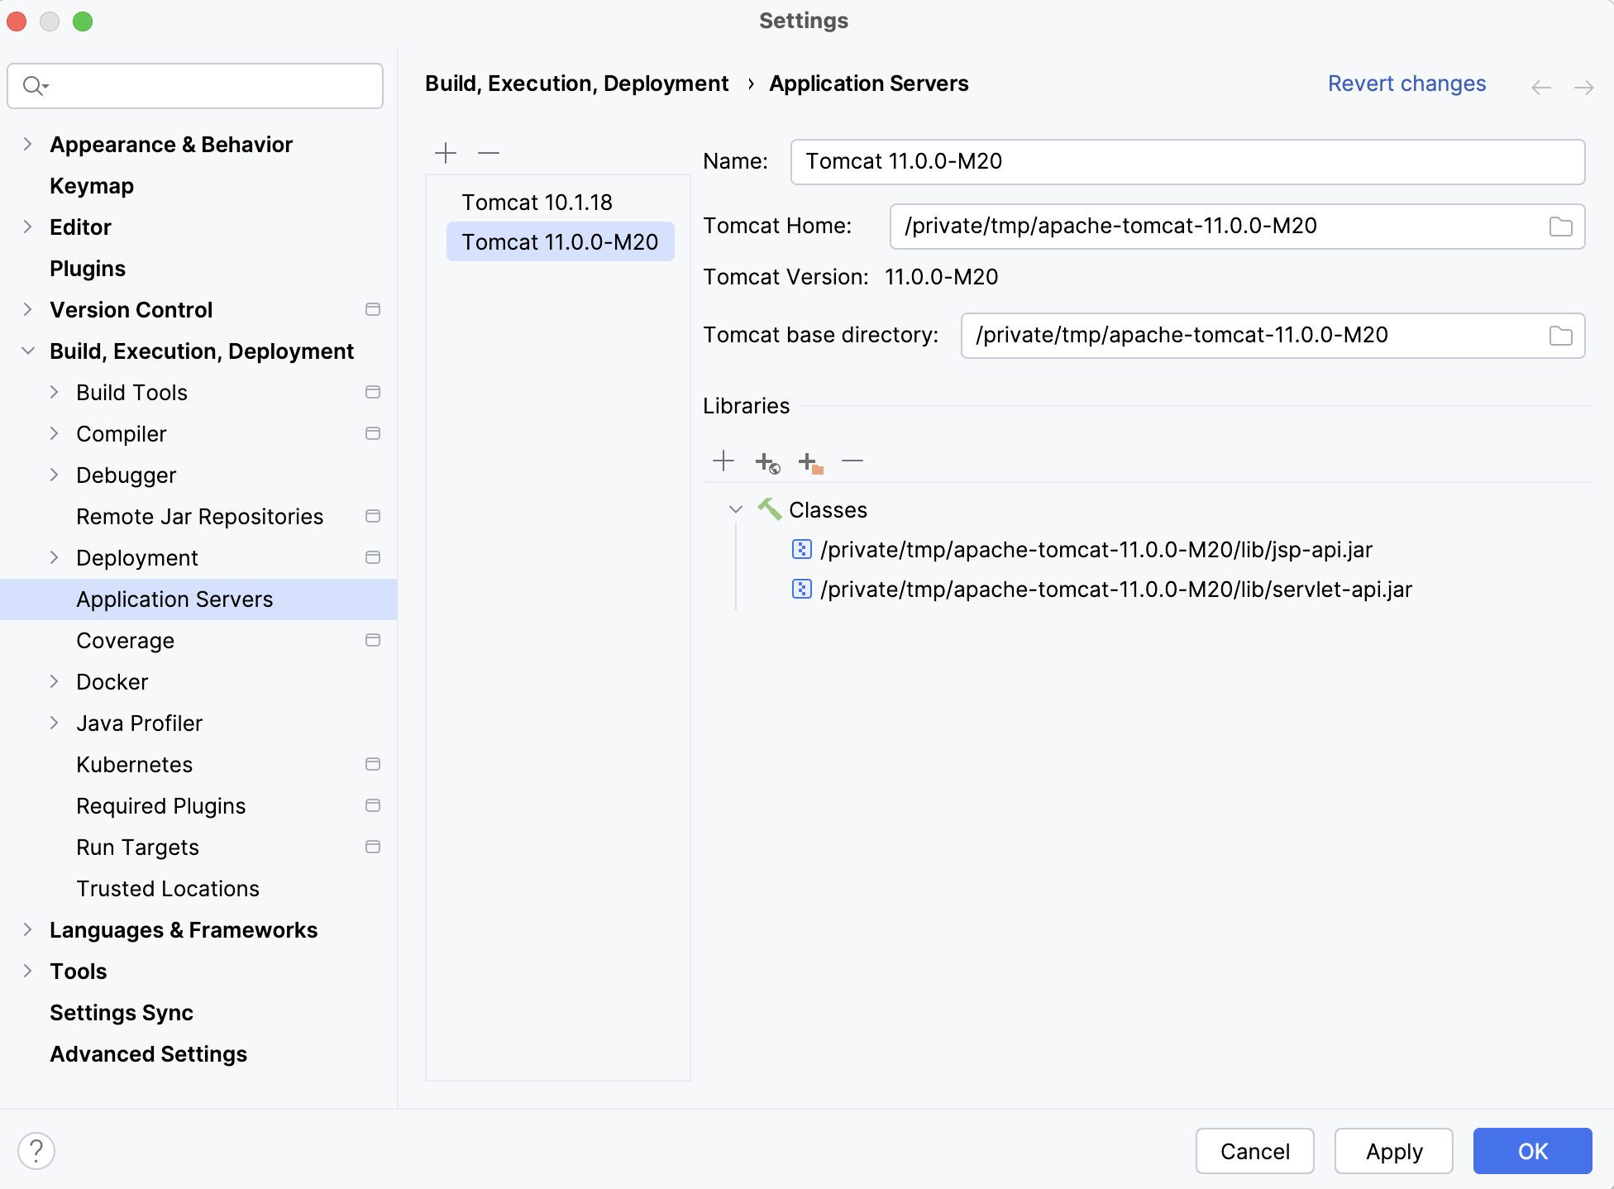

Slide 9
Create a run configuration﻿
IntelliJ IDEA needs a run configuration to build the artifacts and deploy them to your application server.
In the main menu, go to Run | Edit Configurations.
In the Run/Debug Configurations dialog, click the Add button, expand the Tomcat Server node, and select Local.
Fix any warnings that appear at the bottom of the run configuration settings dialog.
Run configuration warning
Most likely, you will need to fix the following:
On the Deployment tab, add the artifact that you want to deploy: JakartaEEHelloWorld:war exploded
On the Server tab, set the URL to point to the root resource:

Slide 10
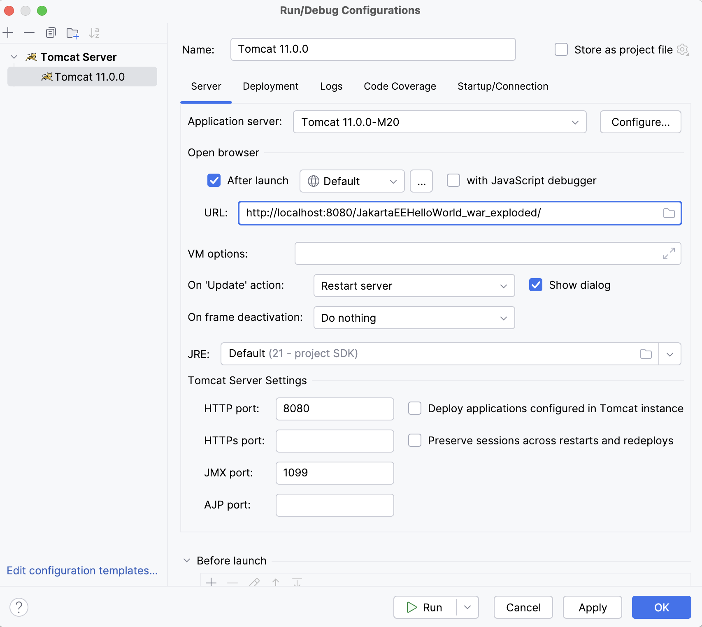

Slide 11
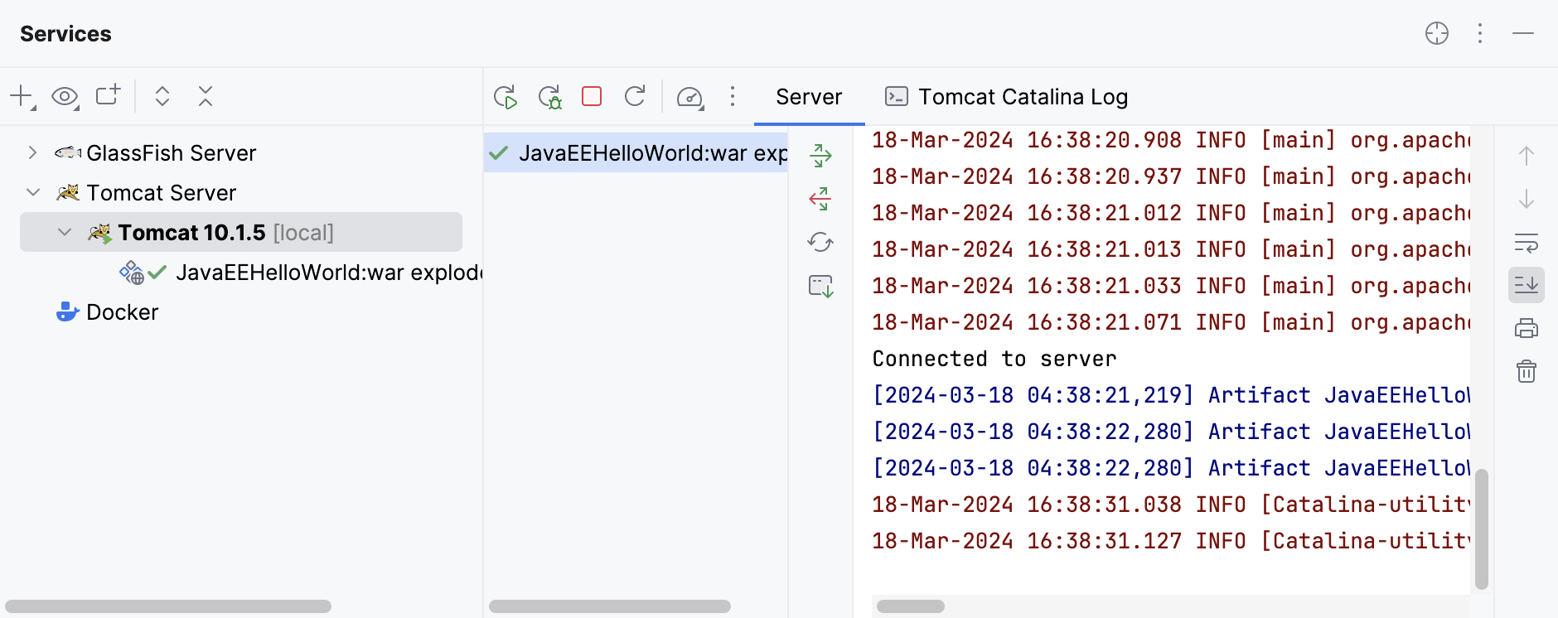

Slide 12
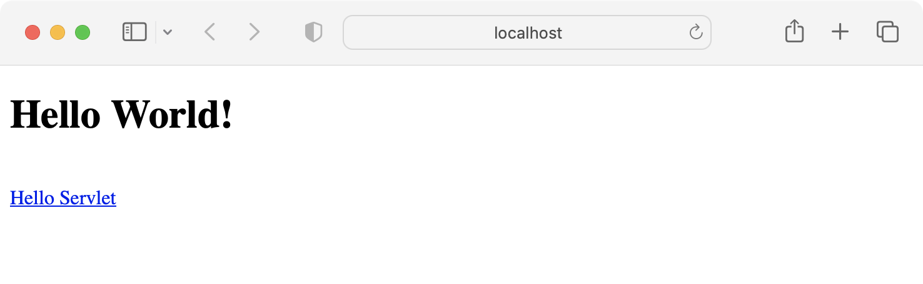

Slide 13
Modify the application﻿
Whenever you change the source code of the application, you can restart the run configuration to see the changes. But this is not always necessary, especially when you can't restart the server. Most of the changes are minor and don't require rebuilding the artifacts, restarting the server, and so on. Let's change the JSP page of the application.
Open index.jsp and change the greeting from Hello World to A better greeting.
In the Services tool window, click The Update Application button or press Ctrl
F10
.
In the Update dialog, select Update resources because the JSP page is a static resource. Click OK.
Refresh the application URL in your web browser to see the new string: A better greeting.

Slide 14
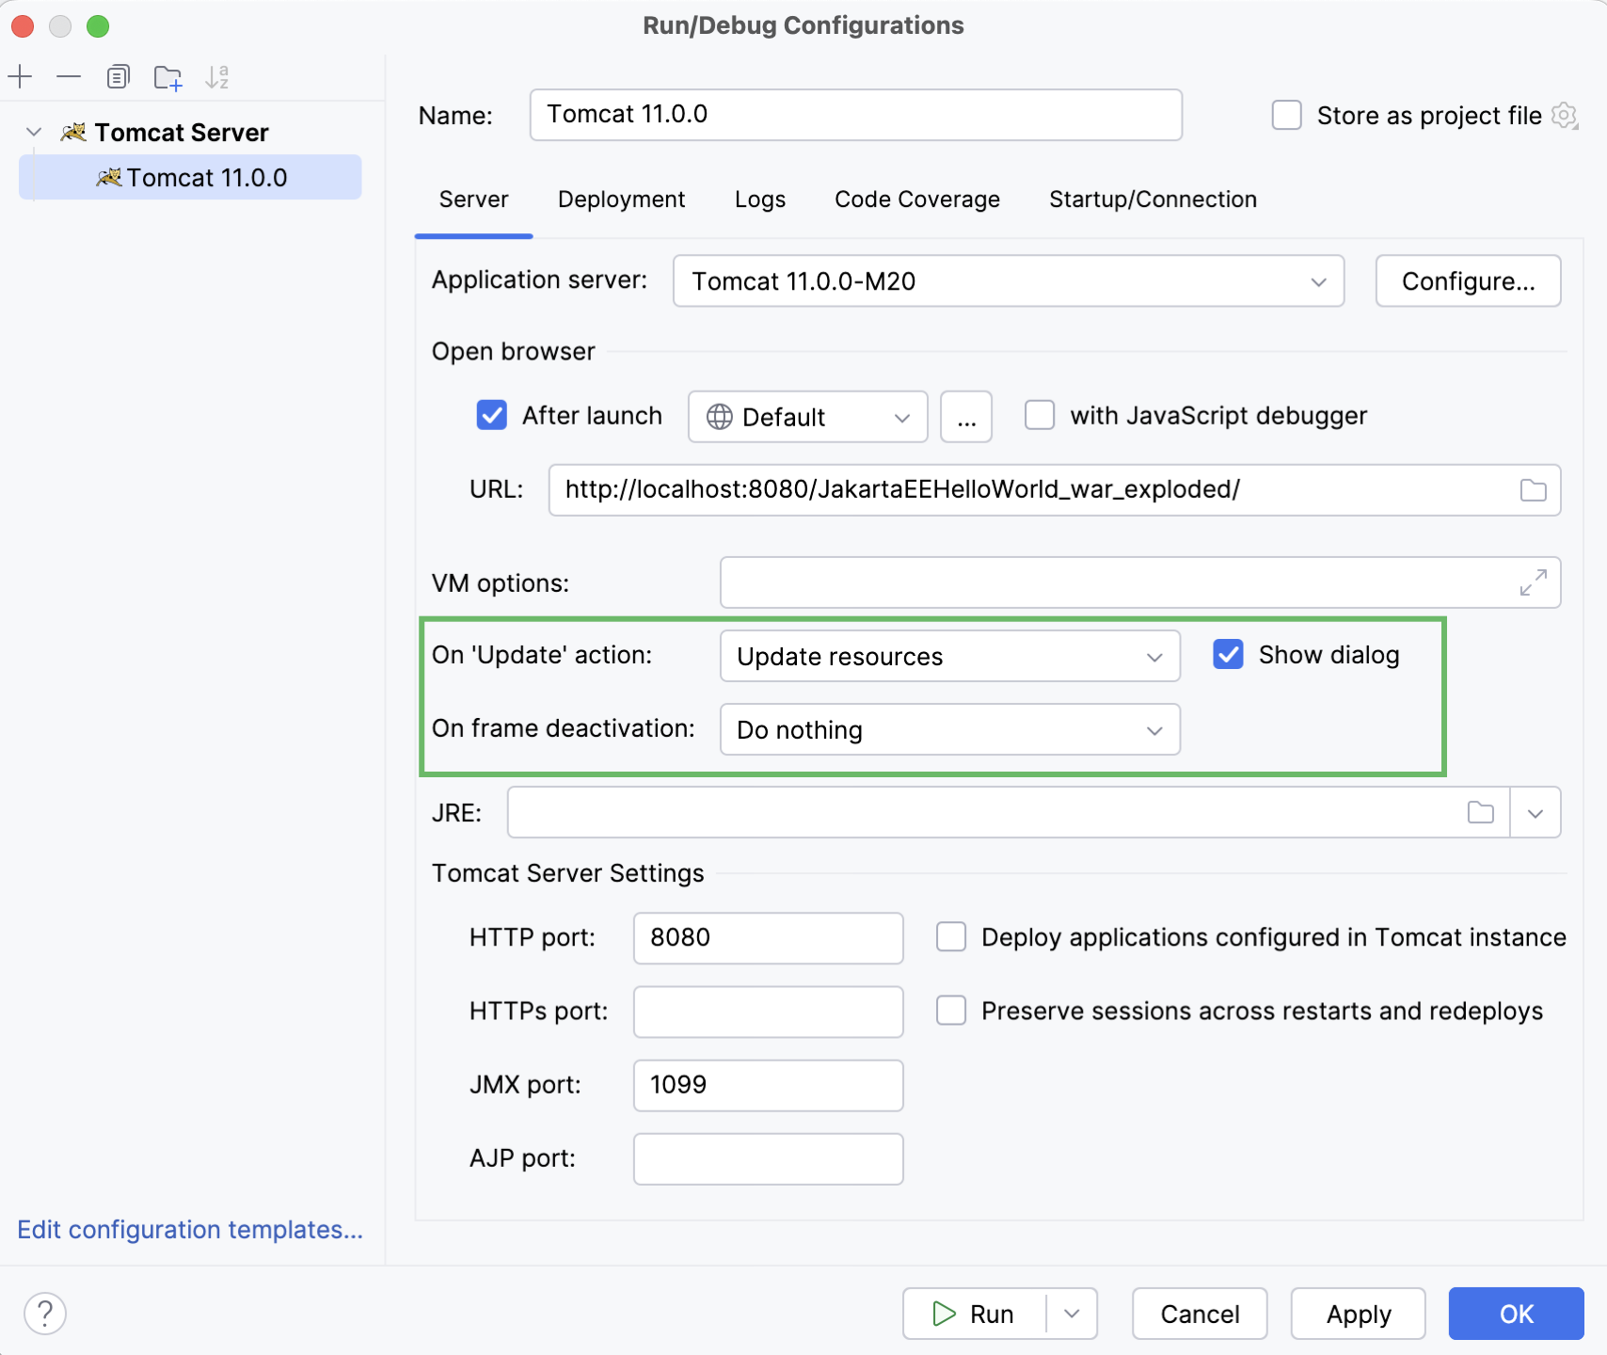

Slide 15
Package the application into a WAR and deploy it on a running server
Let's add a Remote Tomcat run configuration to deploy the WAR artifact to a running server. This assumes that you did not terminate the running server from the previous steps.
In the main menu, go to Run | Edit Configurations.
In the Run/Debug Configurations dialog, click the Add button, expand the Tomcat node, and select Remote.
Change the name of this run configuration to distinguish it, for example: Remote Tomcat 10.1.5.
Open the Deployment tab, click the Add button above the table of artifacts to deploy, and select Artifact. Select the JakartaEEHelloWorld:war artifact and click OK.

Slide 16
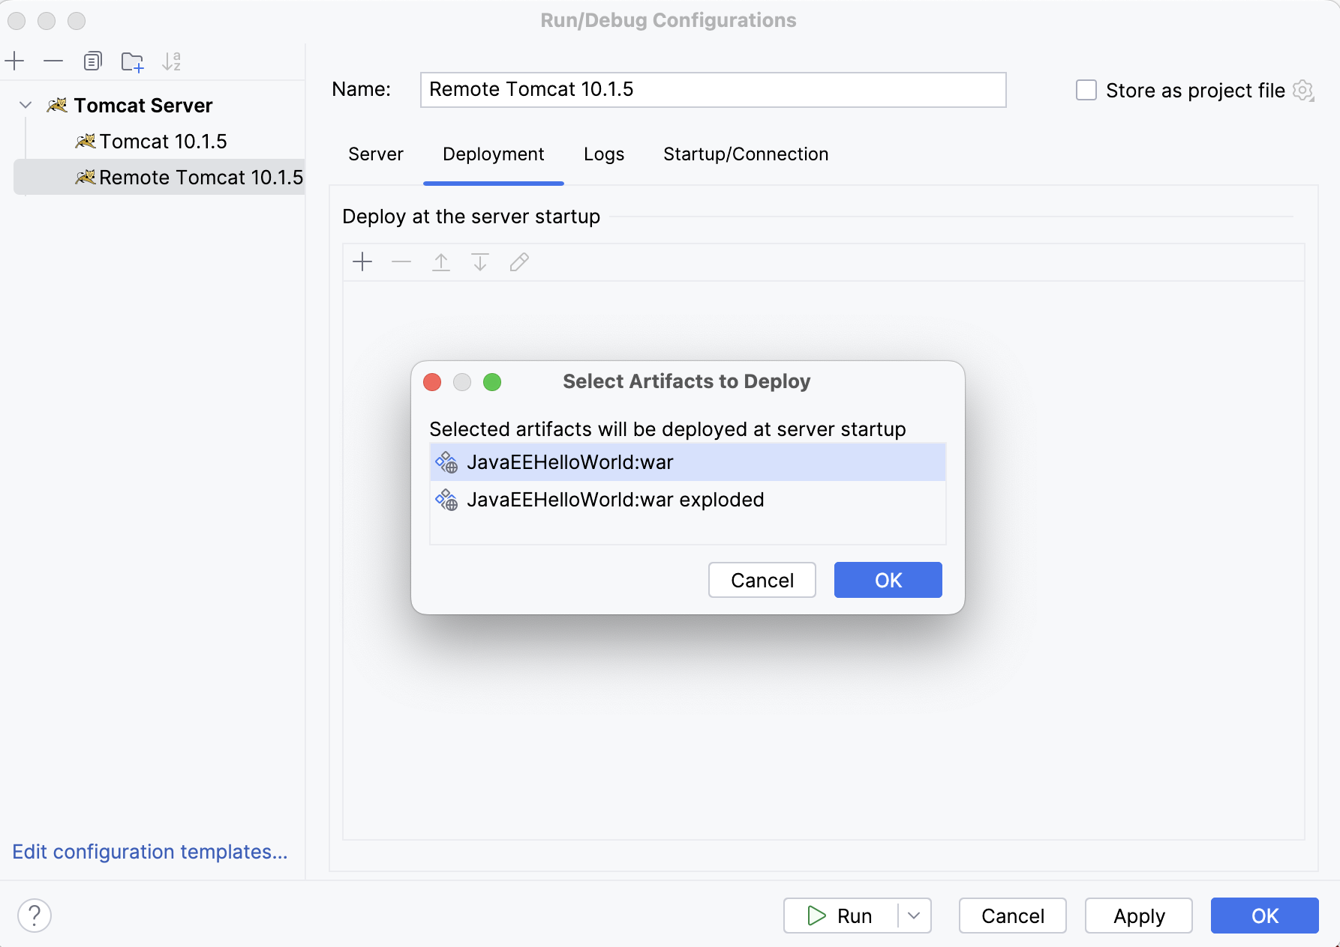

Slide 17
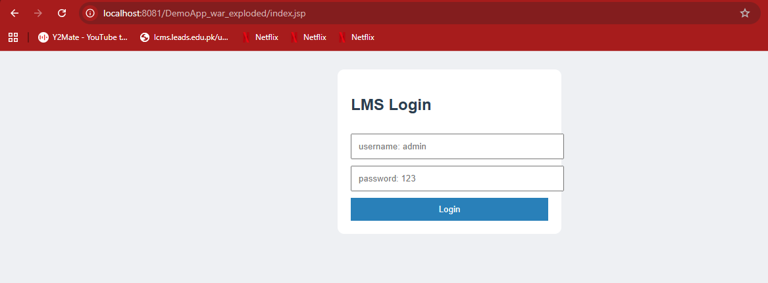

Slide 18
